Slide 1
Economics
Week #1

Slide 2
Topics of Week #1
Economics
Scarcity
Microeconomics vs. Macroeconomics
Opportunity Cost*
Marginal Analysis*
Production Possibilities*
Process of Production
Law of Increasing Cost*
"*" Indicates the most important topics.
Mateer and Coppock: Chapter #1 and #2

Slide 3
Purpose of This Course
Provide you with the tools to
Discover how the world works
Be an informed citizen
Live your life to the fullest
Understand markets
Make better personal decisions

Slide 4
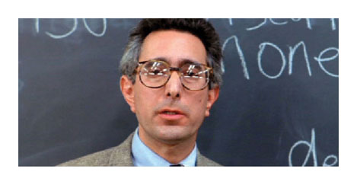
Economics in Ferris Bueller
"Ferris Bueller"
Here is a stereotypical representation of a "boring" economics class.
Hopefully, you'll enjoy this course a little more.

Slide 5
What is Economics?
Scarcity
The limited nature of society's resources.
Nothing is infinite in nature—not even air and water!
Economics
The study of how people allocate their limited resources to satisfy their nearly unlimited wants.
The study of how people make decisions.
Notes:
"Scarcity" is often considered the most basic concept in economics. If scarcity didn't exist, we wouldn't have to study economics at all!
If I have limited time, money, what do I do with it? I have to make a choice. If a society has limited land, labor, capital, timber, water, oil . . . What do we do with those resources? We have to make a choice!

Slide 6
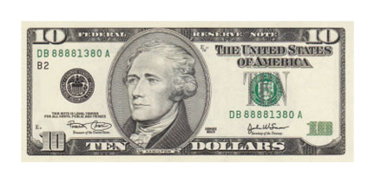
Unlimited Wants? Really?
Which do you prefer?
$10 or $20?
One vehicle or two?
One meal a day or three?
200 gigabytes of disk space or 400?
Idea:
More is preferred to less. This leads to unlimited wants. We will generally never say "no" to having more. It doesn't mean we are "greedy"
Question:
How does this relate to scarcity?
Notes:
Our wants outweigh our ability to produce those wants with our resources at hand.
We can't all freely have everything we want, because we don't have enough of it to go around. That is the basic essence of scarcity.

Slide 7
Microeconomics vs. Macroeconomics
Microeconomics
Concerned with decisions of individuals, households, and businesses.
What happens to my consumption if I lose my job?
Jim decides to buy a house while the interest rate is low.
Macroeconomics
Looks at the broader economy, including inflation, growth, employment, interest rates, and productivity.
What happens to the economy if there is widespread unemployment?
The Federal Reserve decreases interest rates to spur spending and kick start the economy
Notes:
Broadly, economics can be split into two parts: Micro and Macro.
Roughly: Micro = small; Macro = big.
The two examples for Micro and Macro may seem similar, but they are different. The Micro examples look at a single person, while the Macro examples look at economy-wide phenomena.

Slide 8
Microeconomics vs. Macroeconomics
Microeconomics
Individual units that comprise the economy.
Examples
Individual choosing to take a job in Florida or California
Couple decides to start a family.
Firm choosing to open another factory
Effect of government intervention on a single market

Slide 9
Microeconomics vs. Macroeconomics
Macroeconomics
The study of the broader economy
Examples
Inflation
Economic growth and productivity
Unemployment
Interest rates
Aggregate demand and supply

Slide 10
The Five Foundations of Economics
Incentives matter
Life is about trade-offs
Opportunity costs
Marginal thinking
Trade creates value
* We will focus on #3 - #5.

Slide 11
Opportunity Cost
Opportunity Cost
The highest-valued alternative that must be sacrificed in order to get something else.
Not all alternatives, just the next best choice.
In economics:
The cost of something is what you give up to get it.
Scarcity → Choice → Opportunity Cost
Notes:
Every time we make a choice, we experience an opportunity cost. The key to making the best possible decision is to minimize your opportunity cost by selecting the option that gives you the largest benefit.

Slide 12
Opportunity Cost
Easy example: go to the mall or the pool?
Opportunity cost of going to the mall:
Lost opportunity to go to the pool.
Opportunity cost of going to the pool:
Lost opportunity to go to the mall.
Decision-making key:
Minimize opportunity cost by selecting the option that has the largest benefit. Go to whichever you enjoy more, the pool or mall.
Another example
A business makes a profit. That's great!
However, could it have made MORE profit producing something else? This is the economical way of thinking.
Notes:
Profits on a balance sheet are only part of the story, because they only measure how well a business does relative to the bottom line. Accountants cannot measure what might have been better.
Suppose that your business had decided against an opportunity to open a new store. A few months later a rival opened a very successful store in the same location you had considered. Your profits were good for the year, but if you had made the investment in the new store, your profits could have been even better. So when economists mention opportunity cost, they are assessing whether or not the alternatives are better than what you are doing, which considers a larger set of possible outcomes.

Slide 13

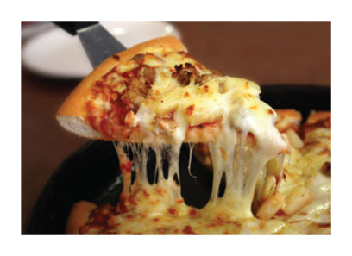
Marginal Thinking (Analysis)
Economic thinking
Systematically evaluating a course of action.
Requires a purposeful evaluation of available opportunities to make the best decision.
Marginal thinking
Evaluate whether the benefit of one more unit of something is greater than the cost.
Margin examples: one more unit (slice of pizza), one more hour of activity (studying, sleeping).
Notes:
Marginal thinking can be quite challenging, but understanding how to analyze decisions at the margin is essential to becoming a good economist.
Think of marginal as examining decisions "one step at a time." How much benefit will ONE more hour of sleep give me? What do I give up by sleeping one more hour? In other words, what are the costs of sleeping for one more hour?

Slide 14
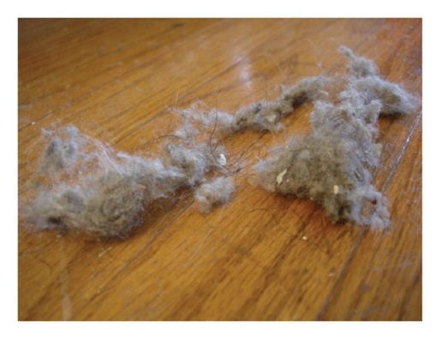
Marginal Thinking Example
Suppose you are vacuuming your living room. Will you move the couch and china cabinet to vacuum underneath them?
Marginal benefits
A small additional amount of carpet is cleaned.
Marginal costs
Vacuuming now takes more time and effort.
Cost-benefit analysis at the margin
Do the action (move furniture) only if the marginal benefits are greater than the marginal costs.
Depends on your valuation of the clean room and the time and effort it takes you to move the furniture.
Notes:
So what's the answer? Should you move the furniture?
Answer:
It depends. Different people will have different answers!
Perhaps a person with strong preferences for a spotless home will gain a large benefit from knowing that every square inch of the carpet is cleaned.
Perhaps you are a strong individual (or have a friend), and the furniture can be moved at a low cost.
Or, maybe the carpet is extremely dirty under the furniture, and the benefits of cleaning it would be large.
In either of these cases, the decision could be rationally made to move the furniture.
On the other side . . .
Maybe you don't care if there is a little dust under the couch.
Maybe you don't have a friend to help easily move the furniture.
Maybe the carpet isn't that dirty under the cabinet, so cleaning it would yield a low benefit.
In either of these cases, the cost-benefit marginal analysis will rationally tell you to not move the furniture. The costs are greater than the benefits.

Slide 15

Is Going to College Worth It?
Let's examine a college education using opportunity costs and marginal thinking.
We often hear people (especially politicians!) say phrases like the following:
College graduates earn $1 million more in their lifetimes than high school grads.
Everyone should go to college.
College will benefit everyone.
We expect all our nation's children to go to college.

Slide 16
Is Going to College Worth It?
Yearly Earnings
A
= College
Z
B
= High school
X = direct costs of college
Y = opportunity cost of not working while in college
Z = college premium; extra money earned.
Y
0
Age
X
In terms of X, Y, and Z, go to college if:
Z > X + Y
*Go to college if marginal benefits are greater than marginal costs!
18
22
Notes:
Who went to college (A or B)?
Click to reveal that A went to college . . .
Why do earnings fall at old age? Perhaps phased retirement, less hours worked. This is true regardless of education level.
What does area X stand for?
X is the direct costs of going to college. Tuition, textbooks, fees. You have to pay someone to get the education.
Click to reveal.
What does area Y stand for?
Y is the opportunity cost of going to college. This area represents wages you COULD HAVE earned while working for 4–5 years. You can ask your students how many of them are currently working full-time. Chances are, very few of them are.
Click to reveal.
What does area Z stand for?
Z is the benefits of college, or the "college premium." It is the extra money a college grad earns each year because of his degree.
Click to reveal.
When should a person go to college?
Give a mathematical statement in terms of X, Y, and Z to answer this question!
Answer is shown on slide.
Click to reveal.

Slide 17

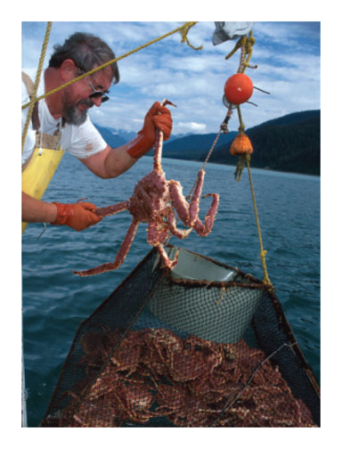
Caveat
Difficult question:
Are the benefits of college greater than the costs of college for everybody?
Think about this: some may have big direct costs or opportunity costs; others will have a small benefit.
Answer:
If the answer to the previous question is "no," then not everyone should go to college.
Economists would disagree with such blanket statements as "everyone will benefit from a college education."
Notes:
Should Lebron James or Bill Gates have gone to college?
No, they would have given up huge earnings. Not worth it for them.
We're not all superstars like Lebron or Bill Gates, but we all should make this choice; we all need to think of our OWN costs and benefits.
Suppose you could take over a crab-fishing boat and earn $96,000 per year. Would you want to give up four years of that income to go to college? Could you earn more than that by doing a different career after college?
Or, suppose you took some technical and shop classes in high school and got a job offer to be a welder making $65,000 per year.
Does college still sound as appealing?
For some people, college will just bring debt and heartache. Other people will greatly benefit, and college is right for them.

Slide 18
Caveat
Please check Lecture Notes Week #1 for Marginal Analysis section.
Marginal Benefit vs Total Benefit
Marginal Cost vs Total Cost
Net Gain
Rational Behavior

Slide 19
Practice What You Know
What can be said about scarcity?
Scarcity forces us to make choices.
Scarcity doesn't affect the super-wealthy.
Scarcity only affects commodities such as oil.
Scarcity generally doesn't affect our day-to-day living.
Notes:
Correct answer: A
Each choice we make results in an opportunity cost.

Slide 20
Practice What You Know
The opportunity cost of buying a good is
the sum of values of all the other goods you could have purchased.
the value of the next-best alternative you could have purchased.
irrelevant since you will purchase your highest-valued good.
the average of values of all the other goods you could have purchased.
Notes:
Correct answer: B
We can't purchase ALL of the goods. Opportunity cost is just the value of the next best thing. Answer "A" is not correct, or else opportunity cost could be infinite!

Slide 21
Practice What You Know
With regards to marginal thinking, an individual will do an action if
the probability of success is greater than 50%.
the action has positive benefits.
the costs of the action are small.
marginal benefits ≥ marginal costs.
Notes:
Correct answer: D
We need to compare the costs and benefits of the action!

Slide 22
Practice What You Know
The governor decides to increase funding for education. However, this will mean decreasing funding for infrastructure. This situation illustrates
trade-offs.
comparative advantage.
incentives.
markets.
Notes:
Correct answer: A
It also illustrates scarcity, choice, and opportunity cost.

Slide 23
The Economy
The ECONOMY is the mechanism through which resource use is organized to satisfy the desires of people living together in a society.
In any economy decisions must be made to determine:
1. WHAT will be produced
2. HOW will it be produced
3. TO WHOM will it be distributed

Slide 24
The Process of Production
Inputs Production Outputs
Labor
Technology
Goods
Capital
and
Natural
resources
Services
1st
St.
Entrepren-
eurship

Slide 25
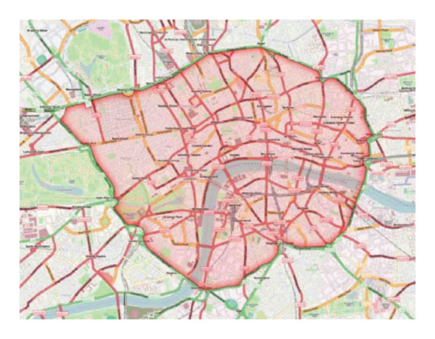

Economic Models
Economists use models to understand the complex real-world economy.
Models
Simplified versions of reality
Built with some assumptions
Are considered good if they predict accurately.
Notes:
Top Picture: Overhead view of road map
A map is a good model. Looks nothing like real life, but it gets you from point A to B successfully. A toy train is a model too; we can look at it and know what it represents.
Bottom Picture: A water molecule (H₂0)
Once again, we see what the model represents, even though that is not what a real molecule looks like.
Economic models are simplified like these models as well. Just because the models are simplified doesn't mean the models are bad!
Models are built with assumptions. Not all models will work in all conditions. We'll see on the next slide that ceteris paribus means we assume some factors do not change.
If a model predicts well, we can use it. If a model's predictions are far off from real data, the model may be missing some important variables or information.

Slide 26
Economic Models
An economic model is a means of explaining how a sector of the economy functions.
Models consist of:
1. Economic Variables
2. Assumptions
3. Implications
Economic models are abstractions that use logic to establish cause-and-effect relationships among economic variables .
Notes:
Top Picture: Overhead view of road map
A map is a good model. Looks nothing like real life, but it gets you from point A to B successfully. A toy train is a model too; we can look at it and know what it represents.
Bottom Picture: A water molecule (H₂0)
Once again, we see what the model represents, even though that is not what a real molecule looks like.
Economic models are simplified like these models as well. Just because the models are simplified doesn't mean the models are bad!
Models are built with assumptions. Not all models will work in all conditions. We'll see on the next slide that ceteris paribus means we assume some factors do not change.
If a model predicts well, we can use it. If a model's predictions are far off from real data, the model may be missing some important variables or information.

Slide 27
Economic Models
Ceteris paribus
Latin: "other things being equal"
Assumption in which we examine a change in one variable, but hold all other variables constant.
Allows us to isolate the effect of a single variable.
Notes:
Using a controlled setting also allows us to experiment with different designs. By altering only a single element, we can test whether or not the change in design is advantageous. This process of examining a change in one variable while holding everything else constant is known as ceteris paribus, from the Latin meaning "other things being equal." This idea is central to model building. If we change many variables simultaneously, and our model predicts better, we have no way of knowing which change is responsible for the improved performance. For this reason, engineers generally modify only one element at a time, test it, and then try different design approaches separately to see which is most successful.

Slide 28
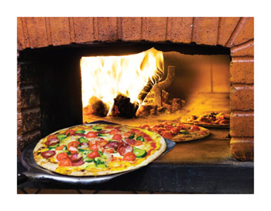
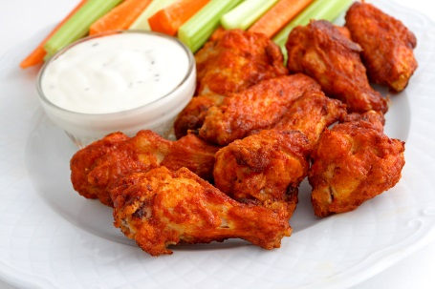
Production Possibilities Frontier
Production possibilities frontier
Combinations of outputs that a society can produce if all of its resources are being used efficiently.
Assumptions of this model
Technology fixed
Resources fixed
Simplified two-good analysis
Notes:
The assumptions of the model help preserve ceteris paribus.
Our two goods are pizzas and wings.

Slide 29
Production Possibilities Frontier
Notes:
Let's begin by imagining a society that produces only two goods—pizzas and wings. This may not seem very realistic, since the entire economy is comprised of millions of different goods and services, but the benefit of this approach is that it allows us to understand the trade-offs in the production process without making the analysis too complicated.
The figure shows the production possibilities frontier for our two-product society. It is important to remember that the number of people and the total resources of this two-product society are fixed. If the economy uses all of its resources to produce pizzas, it can produce 100 pizzas and zero wings. If it uses all of its resources to produce wings, it can make 300 wings and zero pizzas. These outcomes can be found by locating points A and B on the production possibilities frontier. It is unlikely that the society will choose either of these extreme outcomes because it is human nature to enjoy variety.
At any combination of wings and pizzas along the production possibilities frontier, the society is using all its resources to be productive. These points are considered efficient because society is producing the largest possible output from its resources. But what about point F, and all the other points located in the purple shaded region? These points represent an outcome inside the production possibilities frontier and are, therefore, inefficient.
Whenever society is producing along the production possibilities frontier, the only way to get more of one good is to accept less of the other

Slide 30
Production Possibilities Frontier
Why is the PPF downward-sloping?
Must give up one good to increase production of another.
Why are we unable to produce certain combinations?
Scarcity and limited resources
Efficient points
Points ON the PPF (A, B, C, and D)
Inefficient points
Points INSIDE the PPF (F)
Workers goofing off, unused buildings
Unattainable (for now) points
Points OUTSIDE the PPF (E)
Notes:
Downward-sloping PPF illustrates opportunity costs of production. When we produce more wings, we have to give up some pizza. If we are on the PPF, we can't JUST produce more wings since we are already using all our resources. If we want more wings, we must take away some resources currently devoted to pizza production.
Inefficient points are attainable (we COULD produce at F), but undesirable in the sense that we would do better. F has us producing 40 pizzas and 70 wings. We could produce 40 pizzas and 270 wings. We're not doing as well as we can.
We say "unattainable (for now)" because point E may become attainable later on if we experience economic growth, which may increase resources or technology.

Slide 31
PPF and Opportunity Cost
Recall opportunity cost
Highest-valued alternative
What we give up as a result of an action
Opportunity cost in this case is the slope of the PPF: Opportunity Cost of what?
Opportunity cost of producing wings or pizzas?
How do we calculate slope?
What is the slope in this example?
Is it changing or constant?
Notes:
Downward-sloping PPF illustrates opportunity costs of production. When we produce more wings, we have to give up some pizza. If we are on the PPF, we can't JUST produce more wings since we are already using all our resources. If we want more wings, we must take away some resources currently devoted to pizza production.
Inefficient points are attainable (we COULD produce at F), but undesirable in the sense that we would do better. F has us producing 40 pizzas and 70 wings. We could produce 40 pizzas and 270 wings. We're not doing as well as we can.
We say "unattainable (for now)" because point E may become attainable later on if we experience economic growth, which may increase resources or technology.

Slide 32
PPF and Opportunity Cost Nonlinear PPFs
We can draw a more realistic PPF by making it nonlinear and "bowed outward."
The PPF will not have a constant slope in this case.
The slope will get steeper as we move from left to right, and opportunity costs will not be constant.
Law of increasing relative cost
Refers to the increasing opportunity cost of production that occurs as you move along the production.
As we produce more of good A, we have to give up increasingly larger amounts of good B.
Notes:
The production possibilities frontier reflects the increasing opportunity cost of production, known as the law of increasing relative cost. That is, as you move along the production possibilities frontier toward a greater quantity of one good, the costs of production increase relative to the costs of producing the other good. Changes in relative cost mean that society faces a significant trade-off if it tries to produce an extremely large amount of a single good.

Slide 33
PPF and Opportunity Cost Nonlinear PPFs
Intuition of nonlinear PFFs
Inputs (resources) are not perfectly homogenous.
Some inputs are better at making pizza than other inputs.
As we expand pizza production, we'll use the inputs that are the best (Italian chef, dough-tossing master).
If we keep expanding production, we'll have to start using inputs that aren't as good at making pizza. They'll still be doing their best, but they won't make as much pizza as other inputs.
Pizza production doesn't expand at a linear rate!
Notes:
Similarly, moving left to right, think about expanding wing production. We have to take some resources away from pizza, so we want to take away the resources with the lowest opportunity cost (so we give up the least amount of pizza). However, as we produce more and more wings, we have to take away better and better pizza-makers, so the opportunity cost is larger (slope of PPF gets steeper).

Slide 34
PPF and Opportunity Cost Nonlinear PPFs
Notes:
Start at point C. This point means we are efficiently producing 50 pizzas and 250 wings.
In order to produce 20 extra pizzas, society must move from point C (70 pizzas) to point B (90 pizzas). But moving from point C (250 wings) to point B (200 wings) means giving up 50 wings.
Moving from C to B produces a "rise" of 20 pizzas over a 'run" of -50 wings, this produces a slope of negative 0.4. The opportunity cost between points C and B (50 wings) is higher than it is between points D and C where society can produce 20 extra pizzas at a cost of only 30 wings.

Slide 35
Sources
"Principles of Economics with Smartwork Access (ISBN: 978-0-26314-5), 1st Edition, 2013" by Mateer and Coppock
"Economics: Custom Edition for NCSU (ISBN: 9781937435202" by David Hyman

